Slide 1
Student online enrollment system
Week 5 – Final Project
Final Assignment Project
Said Wahid
CST 499 - Capstone for Computer Software Technology
Professor Amr Elchouemi
May 31, 2021

Slide 2


Introduction
Fast
Convenient
Account Creation
Course Registration
Checking Schedule
Notes:
The main purpose of an online student enrollment system is to offer students a fast and convenient way of maintaining their semesterly schedule. The website will provide students with the options of creating an account, logging into the system, searching for classes, registering for available classes, dropping a registered class, or using the waitlist feature.

Slide 3
Software requirements specification
Introduction
Overall Description
Requirements Specification
Functional Requirements
Interface Requirements
Non-Functional Requirements
Notes:
The SRS document explains the description of the software along with the requirements specification gathered. The important part of this document is to go over the functional, non-functional and interface requirements in detail. As any other software system functional requirements relate to what the software must do, while non-functional requirements relate to limits and constraints put on the system by the stakeholder. These limits are not part of the functions of the document, and usually relate to legal, marketing, aesthetics, and company policies that must be part of anything customer facing.

Slide 4
UML Designs Models
Class Diagram
Sequence Diagram
Activity Diagram
Use Case Diagram
Notes:
In this section or document for the system, the most relevant UML diagrams are created for the system. In the case of the Student Enrollment Website, the class, sequence, activity, and use case diagrams are created. In the next slide, we will go through the activity diagram in detail.

Slide 5
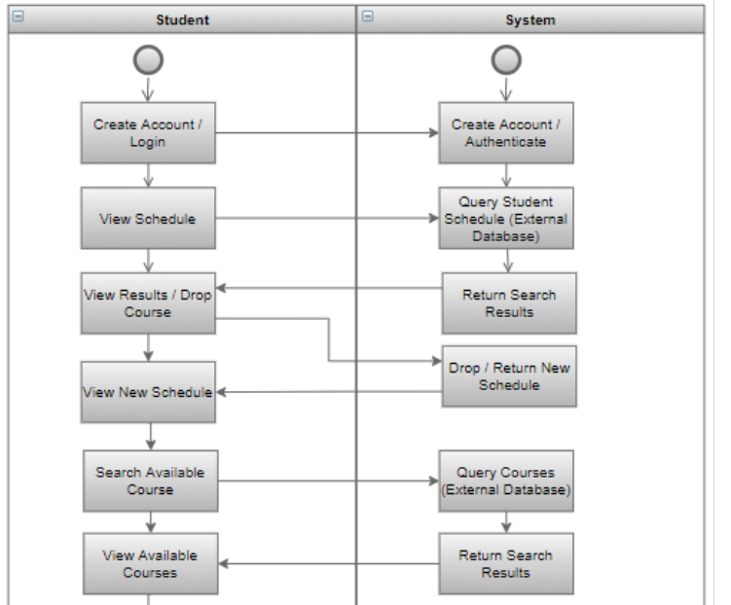
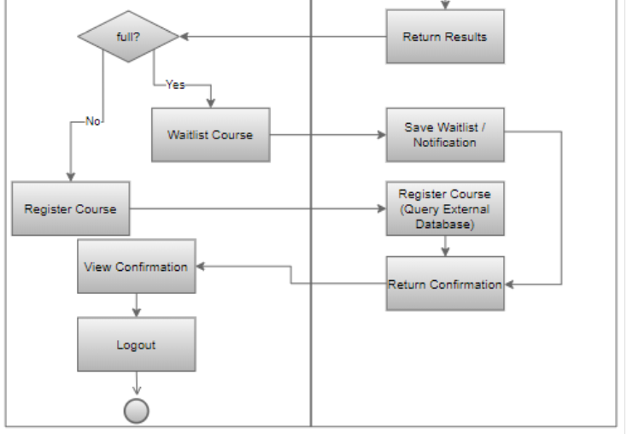
Activity Diagram in detail

Slide 6
Testing levels
Componenet Testing
Integration Testing
System Testing
Acceptance Testing
Notes:
Software development has many stages, and mistakes, errors, and bugs can occur at any step.
It is imperative to have a planned testing process in place that is comprehensive and ongoing. The purpose of ongoing testing at every stage of development is to confirm that the system is built to specifications and can solve the problem it was created for
Enhanced quality, lower cost, better security, and customer satisfaction are benefits of thorough testing in software development.

Slide 7
Creating and testing Preliminary pages
Using XAMPP
1
Using PHPMYADMIN
2
Using MySQL
3
Creating Landing, Login, and Enrollment Pages
Running the PHP Files on XAMPP
Notes:
Two things are required to create and deliver web pages for the Student Enrollment Website – a Web Server to deliver web pages and a database management system to hold database tables. XAMPP is used to provide an Apache server along with the MySQL database management system. The Apache server allows PHP files to be displayed on browser as web pages and MySQL is use to hold the database tables.
The code for the Landing, Login, and Registration pages was written first. The landing page, coded as home.php, serves as the home page for the website. It is a simple page that welcomes users and non-users and present them with login, enrollment, and contact pages. The Registration page allows users to create their account. And, the Login pages allows previously registered users to login to the website.
To view the PHP files as web pages, we can save the files in the htdoc folder of XAMPP and then use any web browser to go to the admin page of the Apache web server.

Slide 8
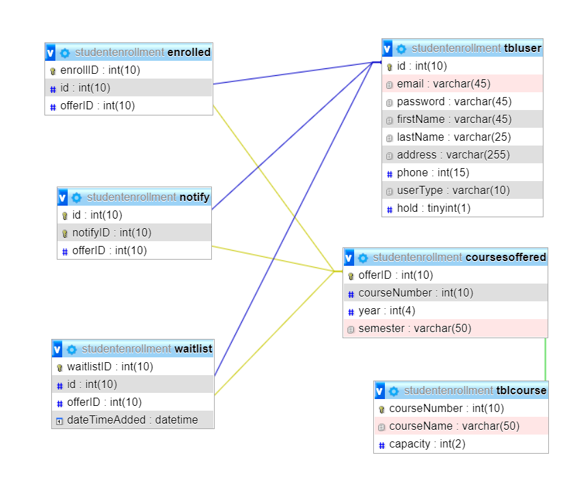
Mysql tables
User Table
Course Table
Courses Offered Table
Enrolled Table
Notification Table
Waitlist Table
Notes:
The database table for the Student Enrollment Website are:
User Table: holds user data
Course Table: holds different course data
Courses Offered Table: assigns courses to semesters and years
Enrolled Table: relates users to different offered courses, creating a schedule for them.
Notification Table: creates and save notifications
Waitlist Table: creates a waitlist and assigns users and classes to it for later use

Slide 9

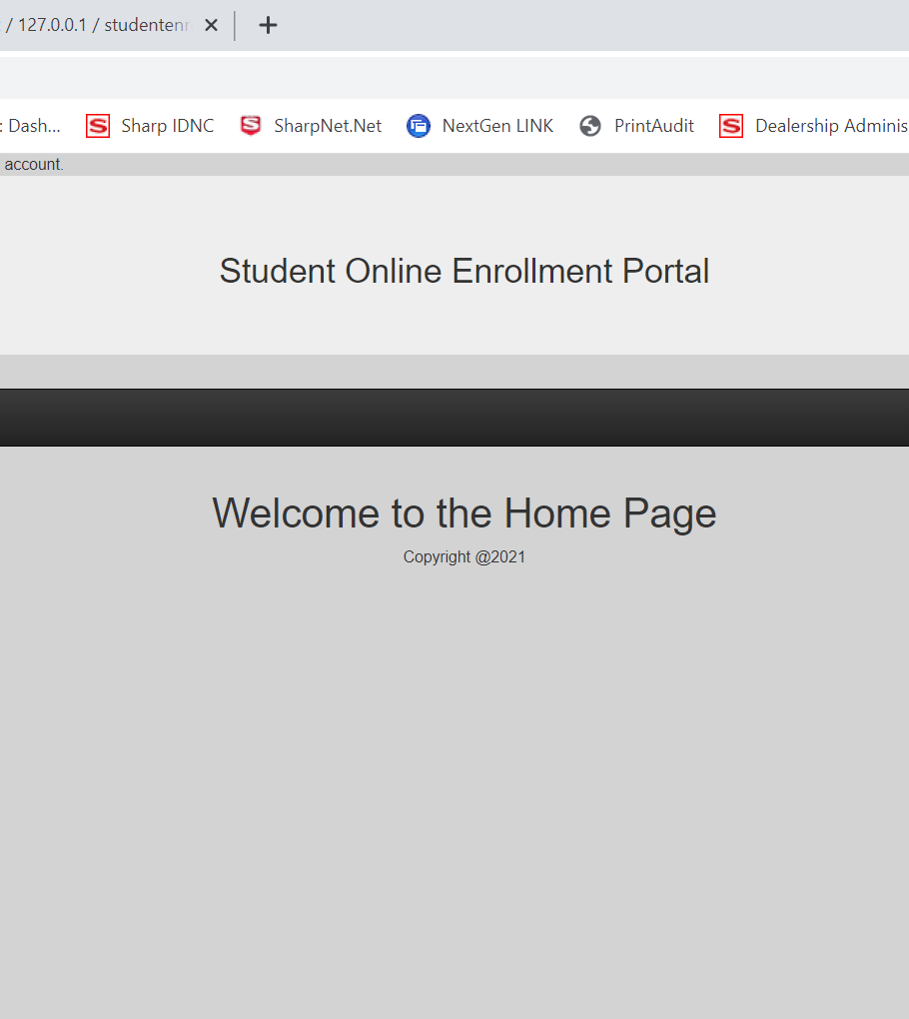
PHP files – website pages
Master, Footer, Contact, Login, Logout, Registration, and Profile Pages
Search page
Add Course Page
Schedule Page
Notes:
The pages used in the Student Enrollment System are
Master, Footer, Contact, Login, Logout, Registration, and Profile: reused from employee registration website, and provide basic functions
Search: let’s users select semester and year for available courses and brings up all available courses
Add course: takes over from search and let’s users add available courses. Also allows using the waitlist option
Schedule: Lets users see what classes they have registered

Slide 10
Thank you
Notes:
In the end, I would like to thank you for your time and hope that this presentation has shed more light on the process of creation for a Student Online Enrollment System. I also hope, that in the process, I was able to explain the use of XAMPP, MySQL, and PHP clearly.

